Slide 1
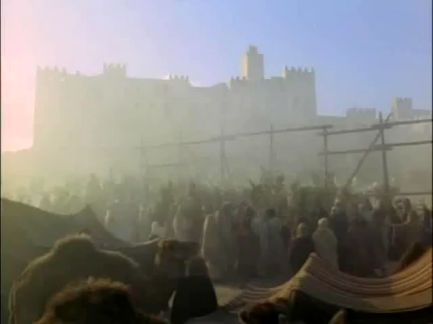
Notes:
From Franco Zefferelli’s, Jesus of Nazareth (1977)

